Slide 1


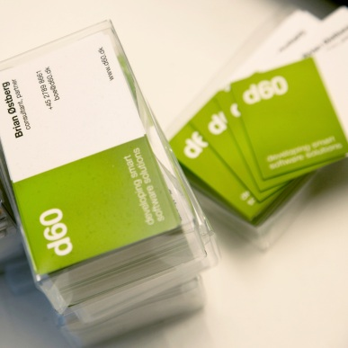



Introduktion til funktionel programmering i F#
d60
developing smart software solutions
Simon Skov Boisen
R&D Ingeniør
@ssboisen

Slide 2
Agenda
developing smart software solutions
Hvordan jeg startede med funktionel programmering
De funktionelle grundsten
Den funktionelle værktøjskasse
En introduktion til et udvalg af F#s features og syntax
Domæne drevet design i F#
d60

Slide 3

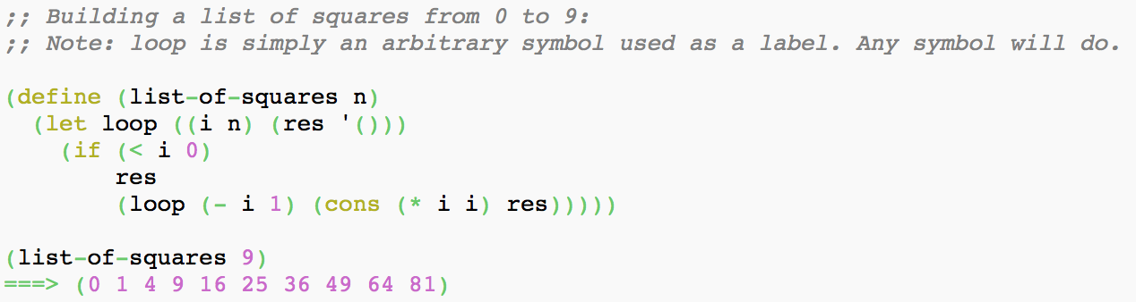
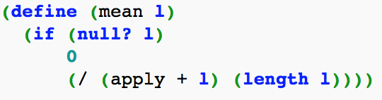

Sådan startede det ud
developing smart software solutions
Tog kursus i funktionel programmering på AU ved Professor Olivier Danvy
Sprog: Scheme og ML
EMACS!!
Droppede at gennemføre kurset!
d60

Slide 4

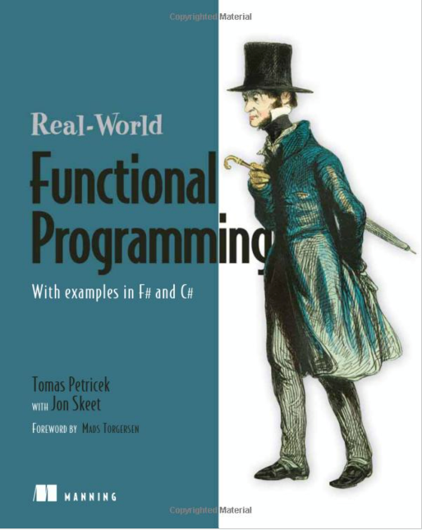
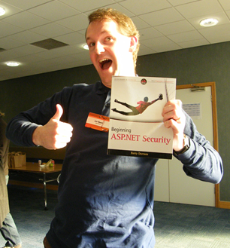


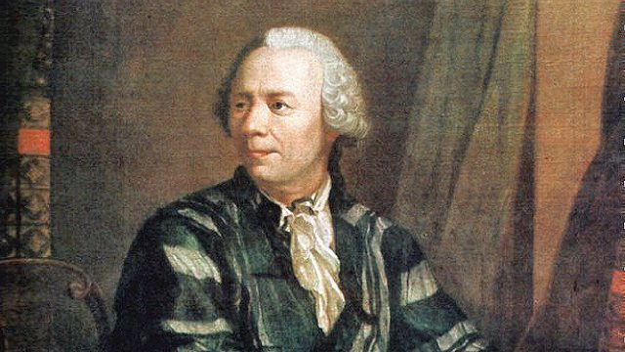

Tre år senere…
developing smart software solutions
d60

Slide 5
developing smart software solutions
Kode intermezzo!
d60

Slide 6

developing smart software solutions
De funktionelle grundsten
d60

Slide 7
developing smart software solutions
Immutability
Purity
Composability
d60

Slide 8
developing smart software solutions
Immutability
d60

Slide 9
developing smart software solutions
Værdier frem for variabler
d60

Slide 10
developing smart software solutions
Ændringer danner nye kopier
d60

Slide 11
developing smart software solutions
let simon = { Name = "Simon"; Email = "ssb@d60.dk"}
let simon2 = { simon with Name = "Simon Skov Boisen" }
d60

Slide 12
developing smart software solutions
let convert_to_simon person =
let simon = { person with Name = "Simon Skov Boisen" }
let simon = { simon with Email = "simon@skov-boisen.dk" }
{ simon with Job = "Programmer" }
d60

Slide 13
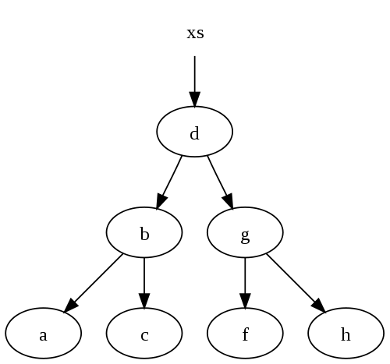
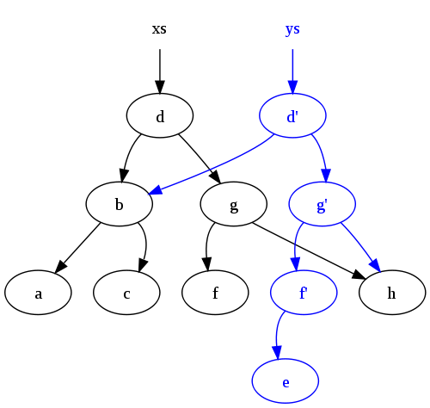
Persistent datastructures
developing smart software solutions
d60

Slide 14
Tilstand
developing smart software solutions
Want more?
Tjek Rich Hickeys talk:
http://www.infoq.com/presentations/Value-Identity-State-Rich-Hickey
Identifikator
Det vi bruger til at referere til ting
I går
Min arbejds-email
Værdi
Immutable facts:
d. 3. marts
ssb@d60.dk
Tilstand
En identitets skiftende værdi
I dag var i går d. 18 marts, i morgen er i går d. 19. marts.
I dag er min arbejds-email ssb@d60.dk men for 2½ år siden var den simon@netlinq.dk
OO:
Tilstand og værdi blandes sammen da vi ikke længere har immutable værdier. Hvis vi skal lave concurrent operationer på, eller gemme, en værdi skal vi have en kopi – og den kan vi kun få ved at standse verden.
d60

Slide 15
developing smart software solutions
Purity
d60

Slide 16
developing smart software solutions
Funktioner frem for metoder
d60

Slide 17
developing smart software solutions
Funktioner uden sideeffekter
d60

Slide 18
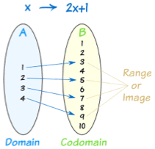
developing smart software solutions
d60

Slide 19
developing smart software solutions
Optimeringsmuligheder
Common subexpression elimination
Memoization
Lazy Evaluering
Parallelisering
d60

Slide 20
developing smart software solutions
Referential Transparency
d60

Slide 21
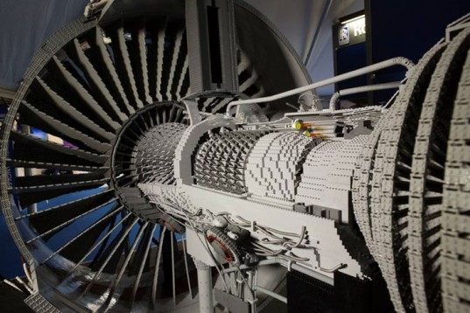
developing smart software solutions
Composability
d60

Slide 22
developing smart software solutions
Kombinere små og simple
byggeklodser til
at skabe komplekse løsninger
d60

Slide 23
Expression baseret
developing smart software solutions
let what_to_bring_for_hiking =
if raining then umbrella else cane
d60

Slide 24
Statement baseret
developing smart software solutions
var what_to_bring_for_hiking = Nothing;
if (raining)
what_to_bring_for_hiking = Umbrella;
else
what_to_bring_for_hiking = Cane;
d60

Slide 25

developing smart software solutions
Den funktionelle værktøjskasse
d60

Slide 26
developing smart software solutions
Første-klasses og anonyme funktioner
let square x = x * x
let square = fun x -> x * x
Operatore er funktioner
let nine = ((*) 3) 3
let three = ((+) 2) 1
let product s = Seq.reduce (*) s
product [1; 2; 3] => 6
Dobbel backtick kan bruges til funktionsnavne
let ``∑`` s = Seq.reduce (+) s
``∑``[1; 2; 3] => 6
let ``when I add 3 and 3 it is 6`` p =
assert ((3 + 3) = 6)
d60

Slide 27
developing smart software solutions
Partial application
d60

Slide 28
developing smart software solutions
let add a b =
a + b
d60

Slide 29
developing smart software solutions
let add5 = add 5
d60

Slide 30
developing smart software solutions
let add5 =
fun x -> add 5 x
d60

Slide 31
developing smart software solutions
add5 6 => 11
d60

Slide 32
developing smart software solutions
add5 10 => 15
d60

Slide 33
developing smart software solutions
let logger (s : System.IO.TextWriter) m =
s.WriteLine(m)
d60

Slide 34
developing smart software solutions
let normalLogger = logger stdout
let errorLogger = logger stderr
d60

Slide 35
developing smart software solutions
normalLogger "noget gik galt!"
errorLogger "noget gik helt galt!"
d60

Slide 36
developing smart software solutions
Minder det jer om noget?
d60

Slide 37
developing smart software solutions
Det er fint granuleret dependency injection på den simple måde!
d60

Slide 38
Den funktionelle værktøjskasse
developing smart software solutions
type Command =
| Deactivate of Id : int * Reason : string
| Reactivate of Id : int * Reason : string
| Checkin of Id : int * Something : int
let dispatch dispatchers command =
dispatchers |> Seq.iter (fun dispatcher -> dispatcher command)
let deactivate dep1 dep2 dep3 command =
match command with
| Deactivate (id, reason) -> printfn "Deactivating %i because: %s" id reason
| _ -> ()
let reactivate dep1 dep2 command =
match command with
| Reactivate (id, reason) -> printfn "Reactivating %i because: %s" id reason
| _ -> ()
let checkin dep1 command =
match command with
| Checkin (id, something) -> printfn "Checking %i with something: %i" id something
| _ -> ()
let dep1 = “I’m some domain service that does cool things"
let dep2 = “maybe I’m a repository"
let dep3 = "i'm some other dependency – maybe I call a webservice"
let dispatchers = [deactivate dep1 dep2 dep3; reactivate dep1 dep2; checkin dep3]
let cmd = Deactivate( 5, "Science!")
dispatch dispatchers cmd ==> prints “Deactivating 5 because: Science!”
Want more?
Tjek Greg Youngs talk:
http://www.infoq.com/presentations/8-lines-code-refactoring
d60

Slide 39
developing smart software solutions
Funktionskomposition
d60

Slide 40


developing smart software solutions
d60

Slide 41

developing smart software solutions
d60

Slide 42




developing smart software solutions
d60

Slide 43
developing smart software solutions
>>
d60

Slide 44
developing smart software solutions
Vi kan ikke se at den ny funktion i virkeligheden består af to mindre funktioner
d60

Slide 45
developing smart software solutions
let add_shipping x = x + 74.0
let add_vat = (*) 1.25
let add_v_and_s = add_vat >> add_shipping
add_v_and_s 12 => 89
d60

Slide 46
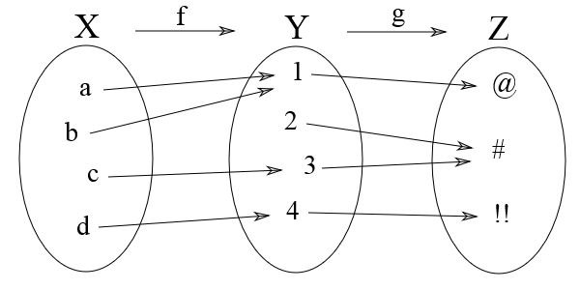
developing smart software solutions
g ∘ f
d60

Slide 47
developing smart software solutions
Højere ordens funktioner
d60

Slide 48
developing smart software solutions
List.map add_v_and_s [125.5; 145.6]
=> [230.875; 256.0]
List.map square [1..3] => [1; 4; 9]
List.filter ((=) 3) [1..3] => [3]
d60

Slide 49
developing smart software solutions
let juxt f g x =
f x, g x
d60

Slide 50
developing smart software solutions
let emailLogger = logger emailWriter
let fileLogger = logger fileWriter
let composedLogger =
juxt emailLogger fileLogger
composedLogger "Something awful"
d60

Slide 51
developing smart software solutions
let orders = [(“order 1”, 125.5); (“order 2“, 145.6)]
let process_orders =
juxt fst (snd >> add_v_and_s)
let process_orders (orderId, total) = orderId, add_v_and_s total
d60

Slide 52
developing smart software solutions
List.map process_orders
[(“order 1”, 125.5); (“order 2“, 145.6)]
=> [(“order 1”, 230.875); (“order 2“, 256.0)]
d60

Slide 53
developing smart software solutions
let tee f value =
f value |> ignore
value
d60

Slide 54
developing smart software solutions
let logger command res =
printfn "logging: %A with result: %A" command res
d60

Slide 55
developing smart software solutions
let dispatch_then_log dispatcher c =
tee (logger c) (dispatcher c)
d60

Slide 56
developing smart software solutions
let decorated_dispatchers =
List.map dispatch_then_log dispatchers
d60

Slide 57
developing smart software solutions
dispatch decorated_dispatchers cmd
=> printer:
Deactivating 5 because: Because Science!
logging: Deactivate (5,"Because Science!")
logging: Deactivate (5,"Because Science!")
logging: Deactivate (5,"Because Science!")
d60

Slide 58
developing smart software solutions
Tennis Kata
Points
Game
40 : 40
Deuce
Advantage
d60

Slide 59
developing smart software solutions
Kode intermezzo!
d60

Slide 60
Lidt om F#
developing smart software solutions
.NET Funktionelt-først sprog
Opensource compiler og specifikation
Immutable by default – mutable by choice
Høj grad af type inference
Man kan skrive meget kortfattet og ekspressiv kode
Høj signal til støj ratio
Et væld af unikke features sammenlignet med andre sprog på CLR’en.
Meget aktivt open-source community:
UI Webtesting DSL
F# til GPGPU
F# til JavaScript compiler
Type-providers til f.eks. JSON, SQL, RegEx, CSV, R, Java
d60

Slide 61


Business Case
developing smart software solutions
Time to Market
Effiency
Correctness
Complexity management
“The present application contains 35 to 40.000 lines of F#-code and an equal amount of C#-code. However, our estimate is that the F# code contains at least 80% of the functionality (which is pretty amazing!). Our experience shows us that the number of code lines shrinks with a ratio of 1/2 to 1/4 by just porting functionality from C# to F#”
”Experienced F# developers regularly solve problems in days that would take weeks using more traditional languages… solving complex problems in an elegant and highly maintainable matter.”
[…] the one stat in the summary that I find most compelling is the defect rate. I have now delivered three business critical projects written in F#. I am still waiting for the first bug to come in. This is not the case with the C# projects I have delivered. […] It might be that I am just on a lucky streak, but I suspect that the clarity and concision of F# code contributes greatly to its correctness.
kilde: fsharp.org/testimonials/
d60

Slide 62
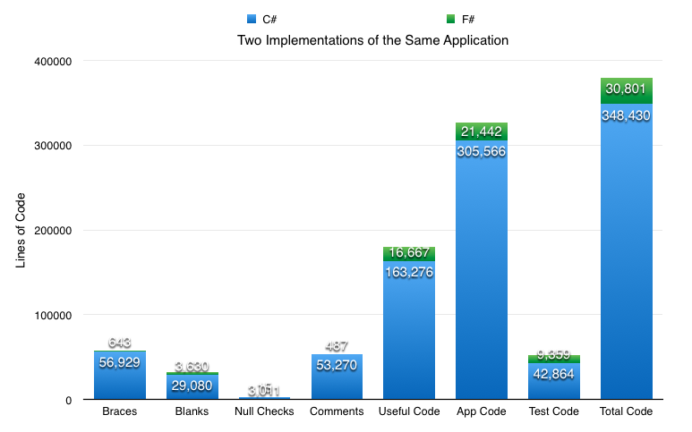
Stats!
developing smart software solutions
Want more?
Blog: http://www.simontylercousins.net/does-the-language-you-use-make-a-difference-revisited/
Slides: http://www.slideshare.net/simontcousins/time-for-functions
d60

Slide 63
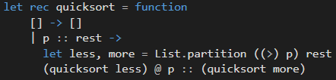
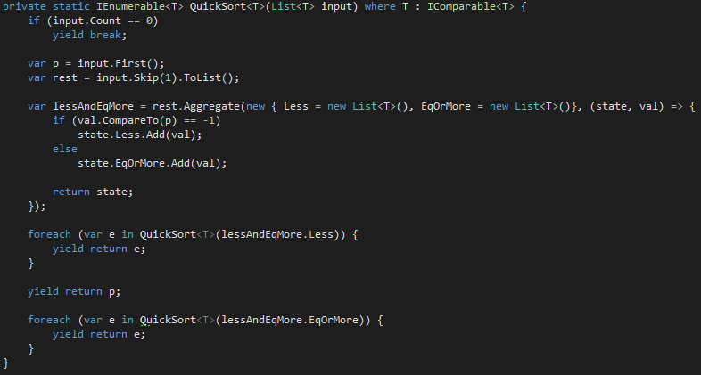
Hvor kortfattet er F#?
developing smart software solutions
d60

Slide 64
Sammenlignet med C#
developing smart software solutions
C#
Partial classes
Implementering af same generiske interface flere gange
NullReferenceException
Tooling
F#
Pattern matching & destructuring
Discriminated Unions
Records
Object expressions
Type providers
Unit of measure
Agents
Options
Choice
Literal tuples
Computation Expressions
Static duck typing
Built-in scriptable
REPL
d60

Slide 65
Klasser i F#
developing smart software solutions
type Person(name : string, age : int) =
member val Name = name
member val Age = age
type Person(name : string, age : int) =
member val Name = name with get, set
member val Age = age with get, set
type DbConnection(connectionString : string) =
interface System.IDisposable
with member this.Dispose() =
printfn "Disposed db-connection"
d60

Slide 66
Object Expressions
developing smart software solutions
type IAddStuff =
abstract Add : int -> int -> int
type ISubtractStuff =
abstract Subtract : int -> int -> int
let calc = { new IAddStuff with
member this.Add a b = a + b
interface ISubtractStuff with
member this.Subtract a b = a - b }
calc.Add 7 8
d60

Slide 67
Records
developing smart software solutions
type Person = { Name : string; Age: int }
let simon = { Name = "Simon"; Age = 29 }
let simonInTheFuture = { simon with Age = 30 }
type Name = { First: string; Last: string} with
member x.FullName = sprintf "%s %s" x.First x.Last
d60

Slide 68
Discriminated Unions
developing smart software solutions
type ContactInformation =
| Email of string
| Phone of int
type Person = { Name : string; CI : ContactInformation }
let p1 = { Name = "Simon"; CI = Email("ssb@d60.dk") }
let p2 = { Name = “Børge"; CI = Phone(53508723) }
type Option<'T> =
| Some of 'T
| None
let doSomething x =
try
Some(x * 2)
with
| _ -> None
d60

Slide 69
Discrimnated Unions: Option
developing smart software solutions
Want more?
Tjek:
http://fsharpforfunandprofit.com/posts/recipe-part2/
type Option<'T> =
| Some of 'T
| None
type Request = { Name : string; Email : string }
let validateNoneBlankName input =
if input.Name = System.String.Empty then None else Some(input)
let validateLengthOfName input =
if input.Name |> String.length > 50 then None else Some(input)
let validateEmail input =
if input.Email.Contains("@") then Some(input) else None
let canonicalizeEmail input =
{ input with Email = input.Email.Trim().ToLowerInvariant() }
let validateRequest =
validateNoneBlankName
>> Option.bind validateLengthOfName
>> Option.bind validateEmail
>> Option.map canonicalizeEmail
let varadicValidation validators =
match validators with
| [] -> fun x -> Some(x)
| fst :: rest -> List.fold (fun o v -> o >> Option.bind v) fst rest
let validateRequest =
varadicValidation [validateNoneBlankName; validateLengthOfName; validateEmail]
>> Option.map canonicalizeEmail
d60

Slide 70
Pattern Matching
developing smart software solutions
Want more?
Tjek:
http://tinyurl.com/fspatternmatch
let p1 = { Name = "Simon"; CI = Email("ssb@d60.dk") }
let p2 = { Name = "Børge"; CI = Phone(53508723) }
[p1;p2] |> Seq.iter (function
| { CI = Email(email) } -> SendEmail(content, email)
| { CI = Phone(pn) } -> SendVoiceMail(content, pn))
let res = Map.tryFind "key" map
match res with
| Some(value) -> printfn "Some value: %i" value
| None -> printfn "No value"
d60

Slide 71
Destructuring
developing smart software solutions
Want more?
Tjek:
http://tinyurl.com/fspatternmatch
let { Name = name } = p1
let (a, b) = (56, "yo“)
let fst :: rest = [5; 6; 7]
let (Email email) = emailContactInfo
d60

Slide 72
developing smart software solutions
Kode intermezzo!
d60

Slide 73
Unit of measures
developing smart software solutions
[<Measure>] type degC
[<Measure>] type degF
let celciusToFehrenheit c =
c * 1.8<degF/degC> + 32.0<degF>
=> c is inferred to must be of type float<degC>
type CurrencyRate<[<Measure>]'u, [<Measure>]'v> =
{ Rate: float<'u/'v>; Date: System.DateTime}
[<Measure>] type EUR
[<Measure>] type USD
let mar1 = System.DateTime(2012,3,1)
let eurToUsdOnMar1 = {Rate= 1.2<USD/EUR>; Date=mar1}
let tenEurInUsd = eurToUsdOnMar1.Rate * 10.0<EUR>
d60

Slide 74
MailboxProcessor aka Agents
developing smart software solutions
type Calc =
| Add of int
| Subtract of int
| Total of AsyncReplyChannel<int>
let calc = MailboxProcessor.Start(fun inbox ->
let rec loop total = async {
let! msg = inbox.Receive()
match msg with
| Add(i) -> return! loop (total + i)
| Subtract(i) -> return! loop (total - i)
| Total(c) ->
c.Reply(total)
return! loop total
}
loop 0)
calc.Post(Add(8))
calc.Post(Subtract(3))
let total = calc.PostAndReply(fun rc -> Total(rc)) // total = 5
d60

Slide 75
MailboxProcessor aka Agents
developing smart software solutions
Want more?
Tjek: http://vimeo.com/68320467
http://tinyurl.com/ghfsagents
module BatchProcessing
open System
open System.Threading
type Agent<'T> = MailboxProcessor<'T>
type BatchProcessorAgent<'T>(batchSize, timeout, ?eventContext:SynchronizationContext) =
let batchProduced = new Event<'T[]>()
let agent = Agent<'T>.Start(fun inbox ->
let triggerEvent batch =
match eventContext with
| None -> batchProduced.Trigger(batch)
| Some ctx -> ctx.Post((fun _ -> batchProduced.Trigger(batch)), null)
let rec loop messages dt = async {
let t = DateTime.Now
let! msg = inbox.TryReceive(max 0 dt)
let dt = dt - int (DateTime.Now - t).TotalMilliseconds
match msg with
| Some(msg) when List.length messages = batchSize - 1 ->
msg :: messages |> List.rev |> Array.ofList |> triggerEvent
return! loop [] timeout
| Some(msg) ->
return! loop (msg :: messages) timeout
| None when List.length messages > 0 ->
messages |> List.rev |> Array.ofList |> triggerEvent
return! loop [] dt
| None -> return! loop messages dt }
loop [] timeout)
[<CLIEvent>]
member x.BatchProduced = batchProduced.Publish
member x.Enqueue v = agent.Post(v)
d60

Slide 76
MailboxProcessor aka Agents
developing smart software solutions
public partial class MainWindow : Window
{
private readonly BatchProcessing.BatchProcessorAgent<char> _batchProcessorAgent;
private readonly ObservableCollection<string> _batches = new ObservableCollection<string>();
public MainWindow()
{
InitializeComponent();
_batchProcessorAgent = new BatchProcessing.BatchProcessorAgent<char>(9, 2000, SynchronizationContext.Current.AsSome());
_batchProcessorAgent.BatchProduced += OnBatchProduced;
}
public ObservableCollection<string> Batches
{
get { return _batches; }
}
void OnBatchProduced(object sender, char[] args)
{
var batch = string.Join(String.Empty, args);
Batches.Add(string.Format("{0} ({1})", batch, DateTime.Now.ToLongTimeString()));
}
private void UIElement_OnKeyUp(object sender, KeyEventArgs e)
{
_batchProcessorAgent.Enqueue(CharUtil.GetCharFromKey(e.Key));
}
}
d60

Slide 77
Computation Expressions
developing smart software solutions
Want more?
Tjek: http://fsharpforfunandprofit.com/posts/computation-expressions-intro/
En måde at lave lækker syntax!
let res = seq {
let counter = ref 0
while true do
yield counter
counter := !counter + 1
}
let res = async { let! res = doSomethingAsync()
let added = res + 5
return added }
logger { let! x = 42
let! y = 43
let! z = x + y
return z }
d60

Slide 78
Type Providers
developing smart software solutions
An F# type provider is a component that provides types, properties, and methods for use in your program. Type providers are a significant part of F# 3.0 support
for information-rich programming
JSON:
type Simple = JsonProvider<""" { "name":"John", "age":94 } """>
let simple = Simple.Parse(""" { "name":"Simon", "age":29 } """)
simple.Age => 29
simple.Name => "Simon"
type GitHub = JsonProvider<"https://api.github.com/repos/fsharp/FSharp.Data/issues">
let topRecentlyUpdatedIssues =
GitHub.GetSamples()
|> Seq.filter (fun issue -> issue.State = "open")
|> Seq.sortBy (fun issue -> System.DateTime.Now - issue.UpdatedAt)
|> Seq.truncate 5
for issue in topRecentlyUpdatedIssues do
printfn "#%d %s" issue.Number issue.Title
d60

Slide 79
Type Providers
developing smart software solutions
Want more?
Tjek: http://fsprojects.github.io/FSharp.Data.SqlClient/
SQL:
open FSharp.Data
[<Literal>]
let connectionString = @"Data Source=(LocalDb)\v11.0;Initial Catalog=AdventureWorks2012;Integrated Security=True"
[<Literal>]
let query = "
SELECT TOP(@TopN) FirstName, LastName, SalesYTD
FROM Sales.vSalesPerson
WHERE CountryRegionName = @regionName AND SalesYTD > @salesMoreThan
ORDER BY SalesYTD"
type SalesPersonQuery = SqlCommandProvider<query, connectionString>
let cmd = SalesPersonQuery()
cmd.Execute(TopN = 3L, regionName = "United States", salesMoreThan = 1000000M)
//output
seq
[("Pamela", "Ansman-Wolfe", 1352577.1325M);
("David", "Campbell", 1573012.9383M);
("Tete", "Mensa-Annan", 1576562.1966M)]
d60

Slide 80
F# - The bad parts
developing smart software solutions
Tooling
Quirks
d60

Slide 81
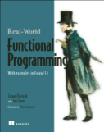
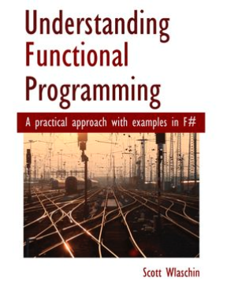

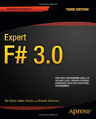
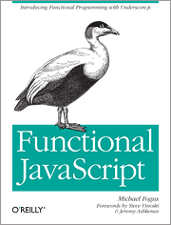

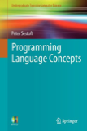
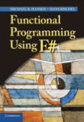
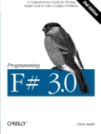
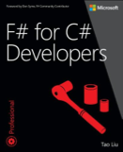
Ekstra materiale
developing smart software solutions
fsharpforfunandprofit.com
fsharp.org
tryfsharp.org
d60

